Slide 1

404 Not Found formerly (Panther Coders)
Group Members:
Ever Lopez
Dung Dang
Hamza Padania
Mohamedzaeem Momin
SangHwan Park

Slide 2
Problem
We want to bring studying, learning, and the idea of sharing knowledge to be as seamless as it is to meet people or even order food with the click of a button.
As students, we have dozens of options to serve us when it comes to our convenience. If we want food, UberEats, Grubhub, Postmates, all available at the quick download of an app. If we want to meet new people, we can go to a university event, we can go swiping through dating apps, we can ask people for help. But if someone wants to study, if someone needs help, if someone has questions they cannot find an answer to, it isn’t as easy nor has the continuity. Because of this, thousands of students miss out on the opportunity to utilize the greatest tool we all have, each other.
Our system is built around the idea that students from our university can share together, study together, and grow together to help each out at an academic level.

Slide 3
Competition
MeetUp
More built around a professional mindset, also applicable to those with similar interests
BUMBLE (new)
Let’s be honest
Chegg
$$$
Coursehero
$$$/resources

Slide 4
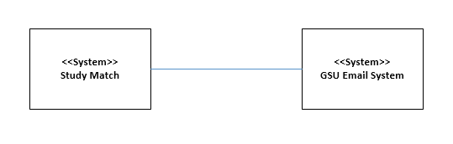
Context Diagram
Use PPT to make pix background transparent
This is our context diagram. Since our system pretty much runs independently, our only border is the GSU Email system that we need to verify that the user has a valid GSU student email.

Slide 5
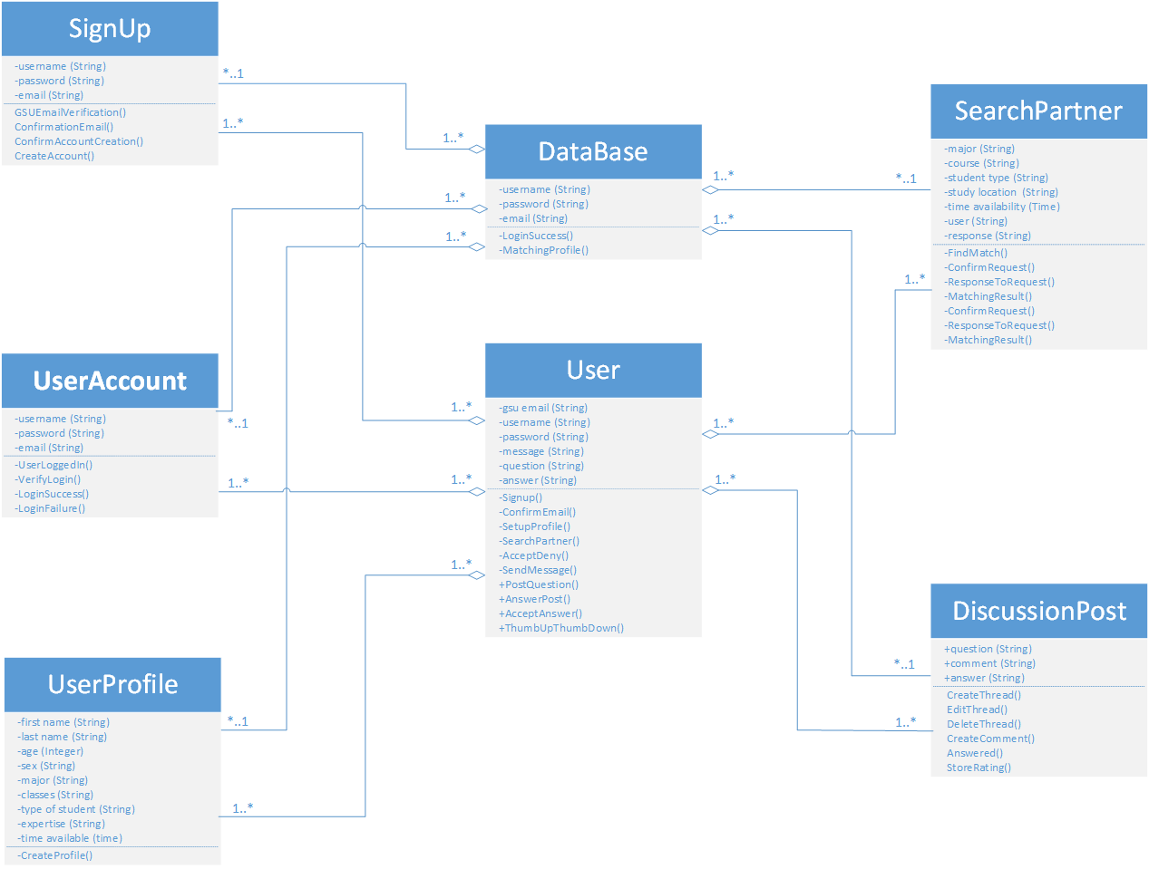
Class Diagram
Here is the class diagram we have built based on our use cases. As you can see, we have 7 objects: User, Database, SignUp, UserAccount, UserProfile, SearchPartner, and Discusion Post. In each of these objects, we have the attributes and the operations performed by each of these objects.
Use PPT to make bg transparent

Slide 6
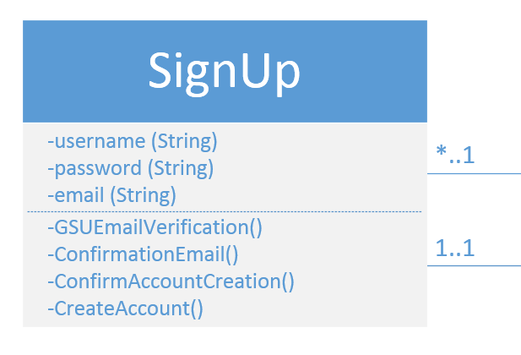
Class Diagram
Take for example, the SignUp class. We have username, password, email as the attributes for this object and the operations performed by this object are GSUEmailVerification(), ConfirmationEmail(), ConfirmAccountCreation(), and CreateAccount(). This object is linked with the User and Database object in an aggregation association. Many signups can be part of 1 database and only 1 signup can be part of 1 user.
Use PPT to make bg transparent

Slide 7
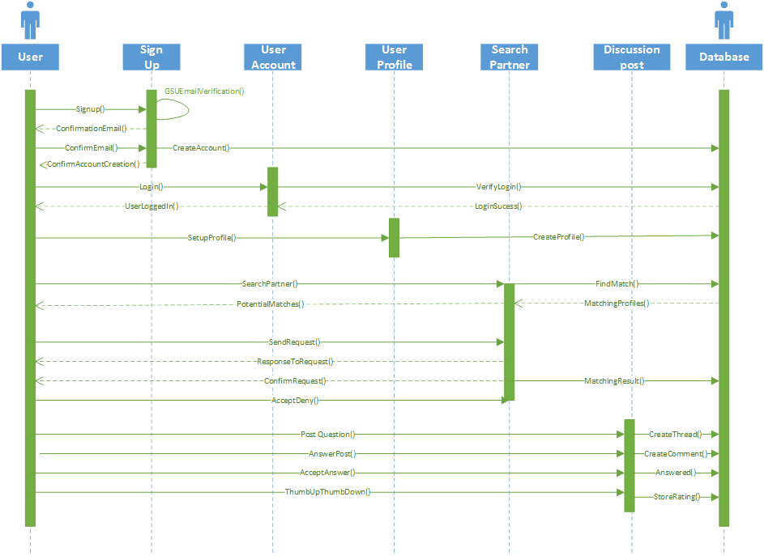
Sequence Diagram
From the class diagram, we developed the sequence diagram to model the behaviors or interactions of these objects with each other. As you can see, we have the 7 classes from the class diagram. Let’s take a look at the Signup object once again.
Use PPT to make bg transparent

Slide 8
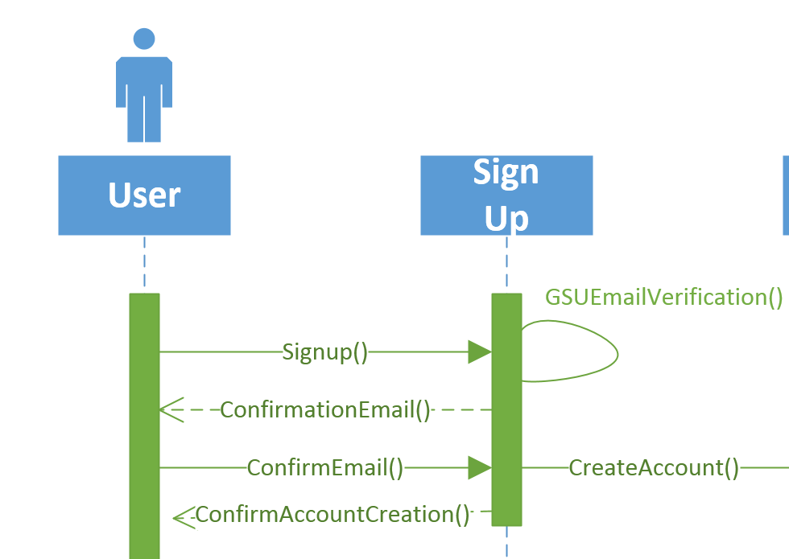
Sequence Diagram
As you can see, the User initiates the Signup() operation on the Signup object. The Signup object will verify the user’s GSU student email address until a valid email is entered. The requirement we have on this email is that it must be @student.gsu.edu address.
The Signup object will then send a confirmation email back to the User. The user will need to confirm that the email is valid by clicking on the link in the email. Once confirmed, the Signup object will create an account for the user in the Database and confirms with the User that an account has been created to allow the User to interact with other objects.
Use PPT to make bg transparent.
Try to whiteout the blue box on the side

Slide 9
Problem Statement (Hamza)
Competition (Hamza)
Context Diagram (Dung)
Sample Use Case (Log in) (Park)
Sample Test Case (Log in) (Park)
System Use Case Diagram (Park)
Class Diagram (Dung)
Class Diagram Sample (Dung)
Sequence Diagram (Dung)
Sequence Sample (Log in) (Dung)
Architecture Model (Ever)
Design Pattern (?????)
Team communication (Ever)
IDE and Language Used (e.g. html, css, bootstrap, php, Hostinger,etc.) (Mo)
Sample Code (Mo)
Testing Automation (?????????????????????????????????????????????????????????????????????????)
Demonstration (Hamza)
Q&A (ALL)

